Slide 1
Industrial Engineering
& Management lesson(4)

Slide 2
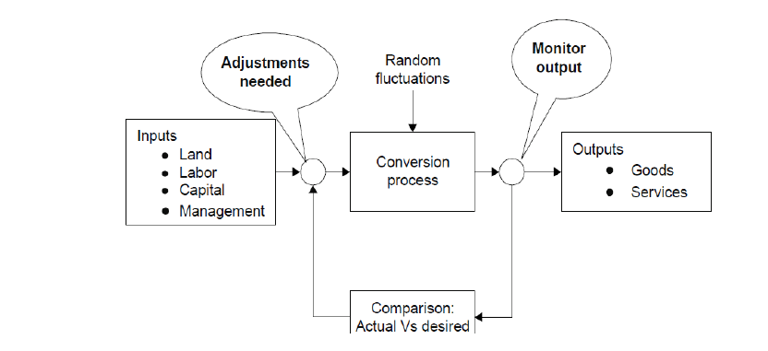
FIG-3 Conceptual model of production management

Slide 3
A systems model of the organization has several sub-systems as shown in the below figure.
Any business organization has finance, marketing, accounting, personnel, engineering, purchasing, and distribution systems besides operations system.
All these systems are interrelated to one another in many ways.

Slide 4
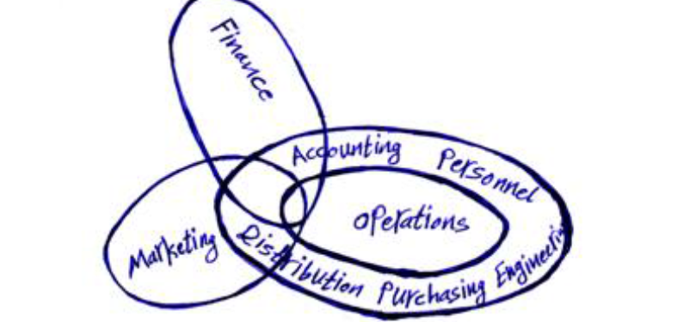
Figure (3) A systems view of a business organization indicating its sub-systems

Slide 5
Production Competitiveness in function
In order to compete in the global market, there are four dimensions of competitiveness that measure the effectiveness of the production function. These four dimensions are:
1. Cost
2. Quality
3. Dependability as a supplier
4. Flexibility

Slide 6
1-Cost :-Price is an important weapon used in the competitive market place. Profitability is also related to the difference between price and cost. Therefore, in order to compete on the basis of price, operations function must be capable of producing at low cost
2-Quality :-Due to Japanese concept of quality and dominance of Japanese market in consumer electronics, automobiles, steel, machine tools etc., more attention is being paid now-a-days on quality.
3- Dependability as a supplier Dependability of supply of off-the-shelf availability is considered as a strong favorable point in competitive market for an organization. Customers, sometimes,may compromise on cost or quality in order to get on –time delivery when they need it.
4- Flexibility A firm must be flexible enough to meet customers' needs. Customers needs may be about service, change in specifications, change in delivery schedule etc.

Slide 7
Productivity
"Productivity" is nothing but the reduction in wastage of resources. The resources may be men, machines, material, power, time and building space etc.
It may also be defined as human Endeavour (Effort) to produce more and more with less and less inputs of resources as a result of which the benefits of production may be distributed more equally among maximum number of people

Slide 8
Difference between Production and Productivity
Sometimes, there arises confusion between production and productivity. It is, therefore, necessary to differentiate them, so that there may not be any confusion.
"Production" of any commodity or service is the volume of output irrespective of the quantity or quality of resources employed to achieve that level of output. Once we put in it element of efficiency with which the resources are employed, we enter the area of productivity

Slide 9
Qualities of good industrial management
A good industrial management is that which can steer through different problems and is capable of achieving its fixed targets. Some of the important qualities of the management are:
1- Collection and analysis of data. It should go on collecting the data about the products, its manufacturing including trends of sales, availability of raw materials etc.
2- Proper research. It should have properly equipped research wing.
3- Not too-rigid. Management should always be prepared to review its decisions.
4- Not too much centralization. As far as possible management should avoid over centralization.

Slide 10
5- Division of labour. The management should be in a position to properly divide the available man-power in such a way that there is no wastage or there is no over-lapping.
6- No wastage. Good management is expected to avoid wastage as far as possible, whether it may be human resource or material. It should see that money is spent in such a way that maximum profits are available to the industry.
7- Proper control. Good management is supposed to exercise discipline and controls over employees and over –expenditure.
8- Stress on training. Management should ensure that the employees at all the levels got refresher and in service training to keep their knowledge up to date.
9- Contacts with the employees. Employees are the life and blood of an organization. Hence management should have both formal and informal contacts with the employees.

Slide 11
FIG-5 Functions of industrial / production management

